Slide 1
The Professional Nurse and Voting
Cynthia E. Sonzogni MSN, RN, NE-BC
New Jersey State Nurses Convention
October 2017

Slide 2
How A Bill Becomes Law in New Jersey
1. Idea Developed
2. Bill Drafted
3. Introduced
4. Committee Reference
5. Committee Action
6. Second Reading
7. Third Reading
8. House Vote
9. Second House
10. Governor’s Action
11. Law

Slide 3
Idea Developed
Legislator decides to sponsor a bill. May ask other legislators in the same house to join as co-sponsor
A4570 – Prohibit the use of “Nurse” title by unlicensed person
N. Munoz– Primary Sponsor District 21 Berkeley Heights, Bernards, Chatham Borough, Cranford, Far Hills, Garwood, Kenilworth, Long Hill, Mountainside, New Providence, Roselle Park, Springfield (Union), Summit, Warren, Watchung, Westfield
N. Chiaravalloti - Primary Sponsor – District 3 Bayonne, Jersey City

Slide 4
Idea Developed
Legislator decides to sponsor a bill. May ask other legislators in the same house to join as co-sponsor
S4570 – Prohibit the use of “Nurse” title by unlicensed person
F. Madden JR – Primary Sponsor District 4 Chesilhurst, Clementon, Gloucester Township, Laurel Springs, Lindenwold, Monroe (Gloucester), Pitman, Washington (Gloucester), Winslow
J. Beach- Primary Sponsor – District 6 Berlin Township, Cherry Hill, Collingswood, Gibbsboro, Haddon, Haddonfield, Hi-Nella, Maple Shade, Merchantville, Oaklyn, Pennsauken, Somerdale, Stratford, Tavistock, Voorhees

Slide 5
Bill Drafted
At direction of legislator's direction,
the Office of Legislature Services,
a non partisan agency of the Legislature,
provides research and drafting assistance,
and prepares the bill in proper technical form

Slide 6
Bill Introduced
During a session, the legislator gives the bill to the Senate Secretary or Assembly Clerk, who reads the bill’s title aloud. This is known as the first reading. The bill is printed and released to the public.

Slide 7
Committee Reference
The Senate President or Assembly Speaker usually refers the bill to a committee for review, but may send the bill directly to the second reading in order to speed its consideration.

Slide 8
Where is S2971 Today?
1/31/2017 Introduced in the Senate, Referred to Senate Commerce Committee

Slide 9
Senate Commerce Committee
Pou, N. District 35– Vice-Chair (*)
Lesniak, R. – District 20
Beach, J. – District 6 (*)
Cardinale, G. – District 39 (*)
Kean, T. – District 21 (*)
Scutari, N. – District 22 (*)

Slide 10
Where is A 4570?
2/13/17 Introduced, Referred to Assembly Regulated Professions Committee
6/3/2017 Sponsorship Updated

Slide 11
Assembly Committee Regulated Professions Committee
Giblin, T. – Chair District 34 (*)
Jimenez, A. D – Vice Chair – District 32 (*)
Cialtarelli, J. – District 16
Downey, J. – District 11 (*)
Handlin, A. – District 13 (*)
Kean, S. – District 30 (*)
Mazzeo, V. – District 2 (*)
Moriarity, P. – District 4 (*)
Zuwicker, A. – District 16 (*)

Slide 12
Doing Your Part
Take the information you have obtained with this presentation
Seek out your Senator and Assembly individuals
Write a letter
E-mail a letter
Call their office
Speak to them in person
Ask them to work on the bills because
there is a lot of work to complete

Slide 13
References
www.njleg.state.nj.us
Congress on Policy and Practice (COPP)
New Jersey State Nurses Association

Slide 15
Legislative Update
WIIFM (What's in it for Me)
Mary Krug
Kathi Burkhart

Slide 16
All ships rise with the tide-Consumer Access to Healthcare Act

Slide 17
So what does this mean for you…
The Consumer Access to Health Care Act S 2354 (Vitale/Madden) A 3512 (Munoz/Jasey/Benson/Coughlin) eliminates the requirement of a joint protocol with a physician for Advanced practice Nurses (APN) to prescribe medications
Veterans Administration -Adopted FPA in the National Register December 2016

Slide 18
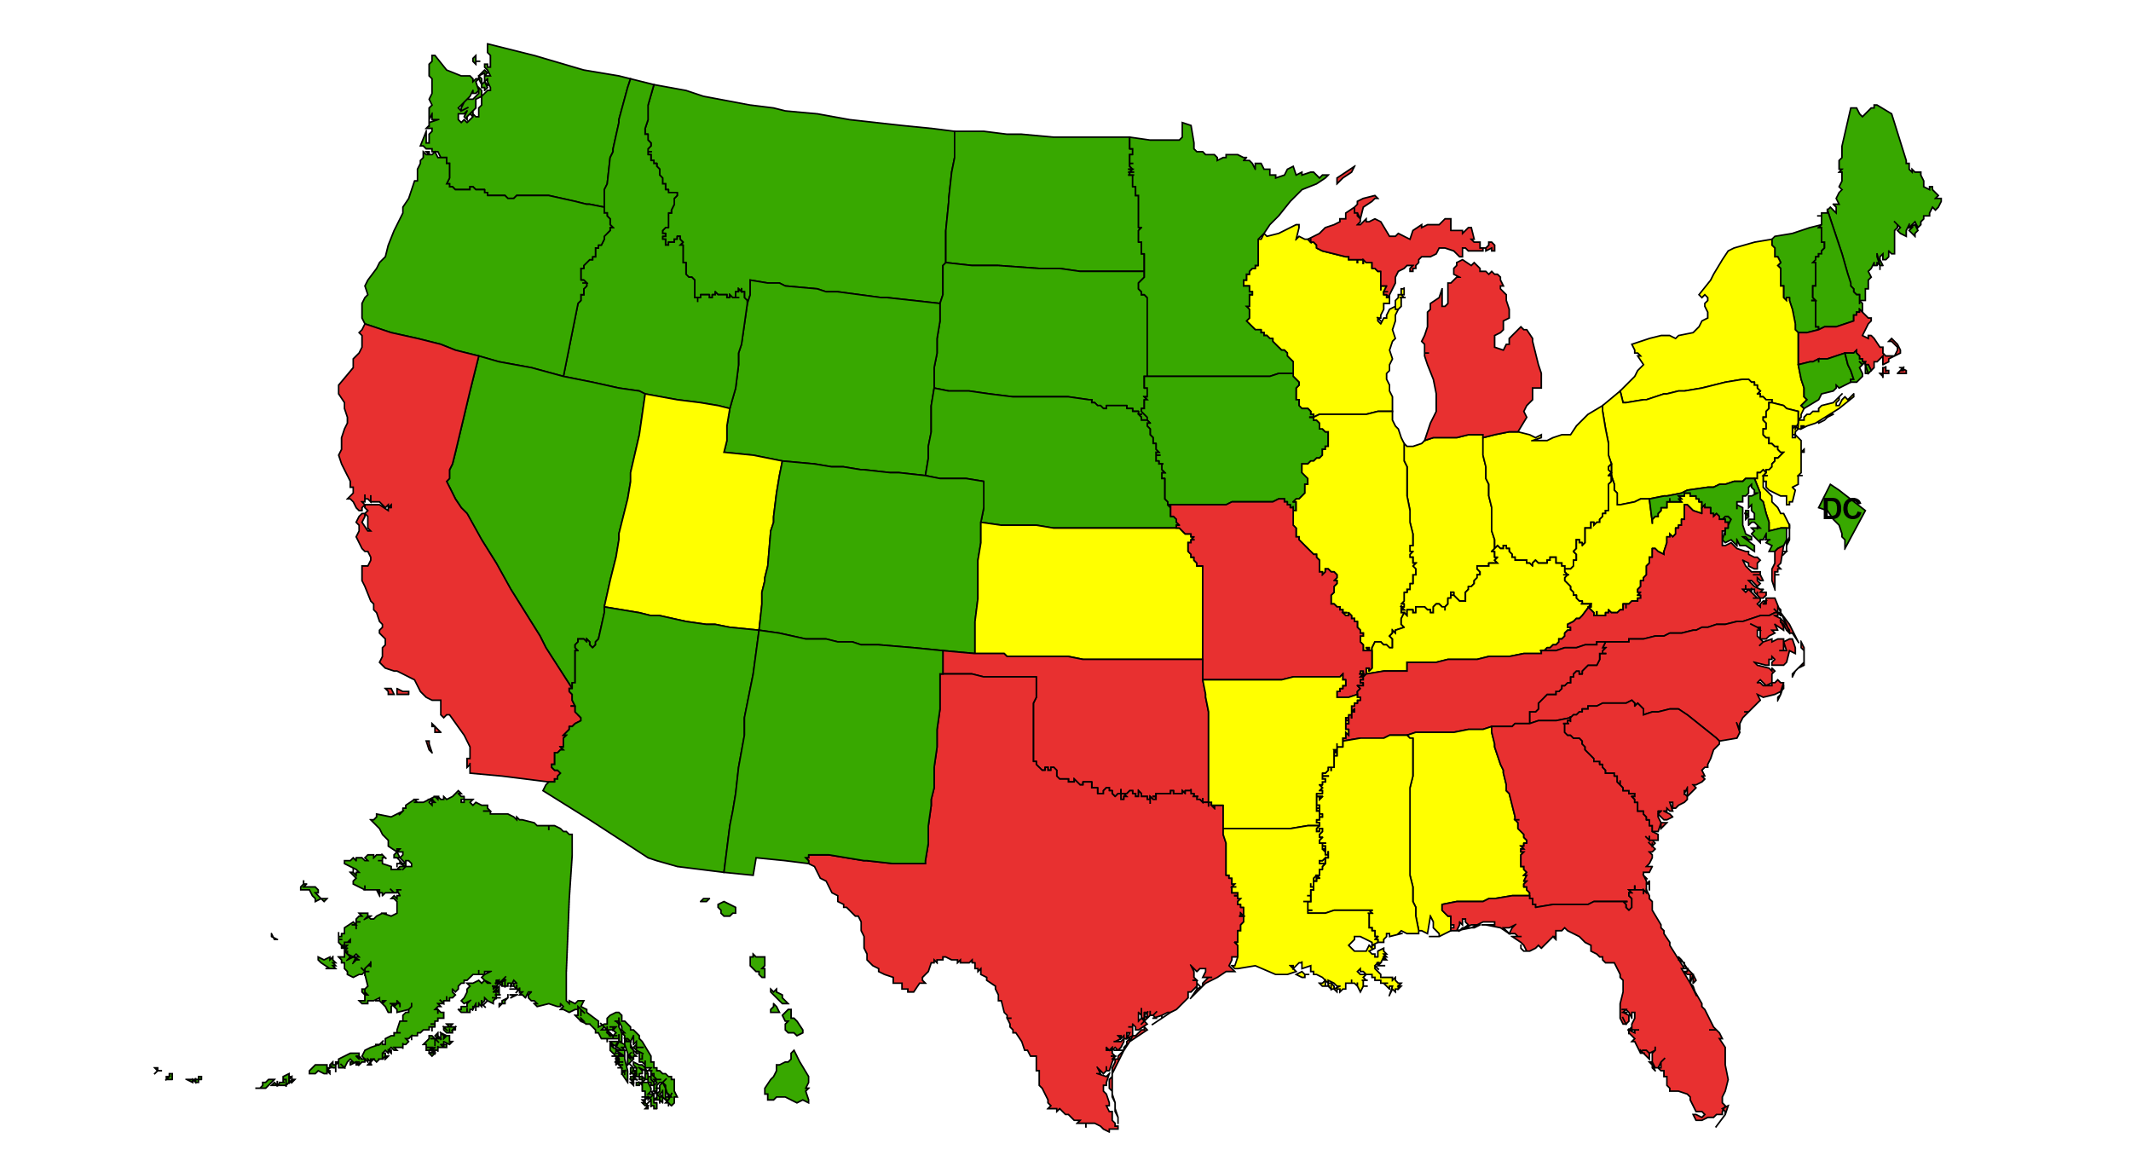
GREEN-States with FPA-22 +DC
YELLOW-Reduced-16
RED-Resticted -13

Slide 19
What is Full Practice Authority (FPA)
Full Practice Authority-(FPA) The American Association of Nurse Practitioners (AANP) Policy Statement,2013)-Defined: “the collection of state practice and licensure laws that allow the Advanced practice Nurse (APN) to evaluate patients, diagnose, order and interpret diagnostic tests, initiate and mange treatment plans [and } prescribe medications under the licensure authority of the state board of nursing.
Sometimes referred to as…Autonomous or independent practice
(AANP Policy Statement ,2013,retrieved from aanp.org 1/2/2014)

Slide 20
A little bit of history…..
Last substantial bill passed addressing APN practice was in 1991-APN’s could practice autonomously under their scope of practice(including physical assessment, diagnosis, and management of episodic and chronic illness, ordering labs, x-rays and diagnostic tests, performing treatments and procedures and referring to other providers as appropriate. –except for medications which requires a joint protocol with an NJ MD
This provision was written into the bill to assure the public was safe as there was not history of APN in NJ with Rx privileging
Since that time there has been less than -02% of litigation referencing APN practice -

Slide 21
More history
2008-NJSNA membership vote to remove the joint protocol
NJSNA developed and introduced the Consumer Access to Health Care Act
2012-S 2354 (Vitale/Madden) A 3512 (Munoz/Jasey/Benson/Coughlin)
2014 –re-introduced S 870 A 906-removal of the joint protocol and the bill included global signature
2016-re-introduced as S 1282 A 906 referred to Assembly Health and Senior Services Committee
To be re-introduced next legislative session…….

Slide 22
Conditions of the Bill include:
Use of the NJ Prescription Blank
Satisfying Continuing Education Requirements for CDS
APN’s with less than 24 months or 2400 hours of active practice will require formal collaborating agreement with provider
The bill also provide global signature authority

Slide 23
Sponors
Munoz, Nancy-Primary
Jasey,Mila-Primary
Benson, Daniel-Primary
Coughlin, Craig, Primary
Diegnan, Patrick-Co-Sponsor
Sumter, Shavonda-Co-Sponsor
Caride, Marlene-co-Sponsor
McKeon, John-co Sponsor
DeAngelo, Wayne-Co-Sponsor
Schepisi, Holly-Co-Sponsor
Ciattarelli, Jack-Co –Sponsor
Jones, Patricia –Co Sponsor

Slide 24
You wouldn’t call a horse a donkey or a Mule…..Nurse Title Bill

Slide 25
Nurse Title Bill S2971 A4570
Prohibits the use of “nurse “ title by unlicensed persons
The title nurse is to be uses when the person is licensed as a professional nurse, practical nurse or advanced practice nurse
Primary Sponsors Senate Version –Fred Madden (District 4) and James Beach (District 6)
Primary Sponsors Assembly Version-Nancy Munoz (District 21) and Nicholas Chiaralioti (District 31)
39 States have passed legislation in an effort to protect the public against harm from health practitioners who are not licensed

Slide 26
Bill History
1/2017 Introduced -to Senate –referred to Senate Commerce Committee
2/2017 Introduced to the Assembly-referred to Assembly Regulated Professionals Committee
A-4570 Primary Sponsor Nancy Munoz (D21) and Nicholas Chiaravalloti (D31)
Christian Sciences Nurses –requesting exemption

Slide 27
Nurse Licensure Compact (NLC)

Slide 28
Nurse licensure Compact(NLC)
Allows nurses with a multistate license to practice physically, telephonically, or electronically in their home state and other original NLC states
As of July 20,2017 26 states have enacted the NLC –currently pending in NJ and Massachusetts

Slide 29
11 Uniform License Requirements
1.Meets requirements
2.Graduate of Board Approved Program
3.Pass English proficiency
4.Pass NCLEX-RN or NCLEX-PN
5.Eligable or holds license
6.Fingerprints/Background Check
7.No State /Federal Felony convictions
8. No Misdemeanors
9. Not in an alternative program
10.Is requires to self-disclose current participation in alternative program
11. Valid SS #

Slide 30
Bill History –senate
S103 Primary Sponsors were Vitale (D19) Whelan (D2) Co-Sponsor Madden (D4)
1/12/2016 Introduced to the Senate, referred to Senate Health ,Human Services and Senior Citizens Committee
6/1/2017 Reported from Senate Committee with Amendments,2nd reading
6/1/2017-Referred to Senate Budget and Appropriations Committee
6/1/2017 Voted on:8 yes 0 no 1 not voting 0 abstained

Slide 31
Bill History assembly
A 3917 Conway (D7) and Moriarty (D4) Primary Sponsors
June 20,2016 Introduced , Referred to Assembly Health and Senior Services Committee
June 19. 2017 Reported out of Assembly committee with Amendments, 2nd reading
June 19,2017 votes in: 10 yes, 0 no, 3 not voting, 0 Abstains

Slide 32
The End……???

