Slide 1
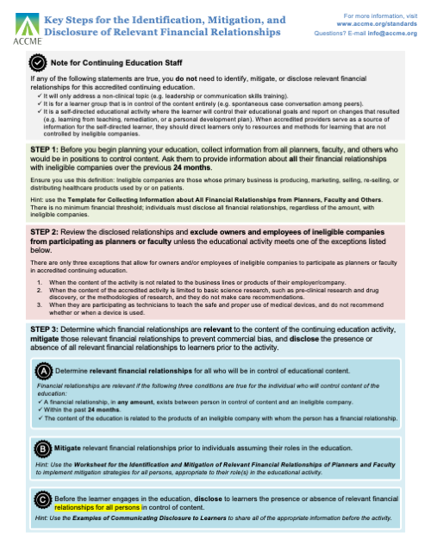
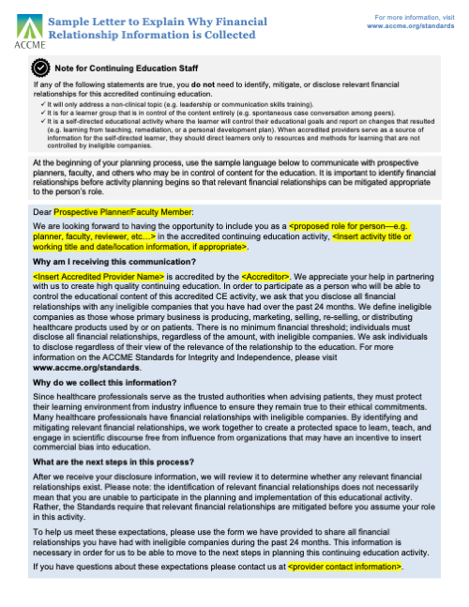
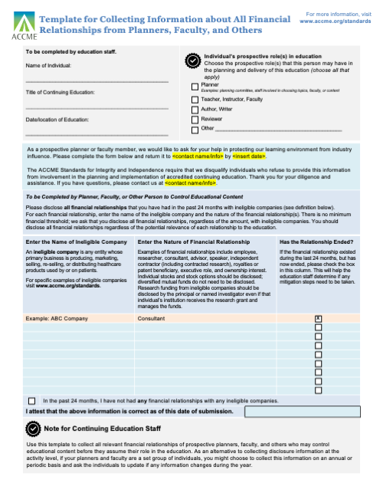
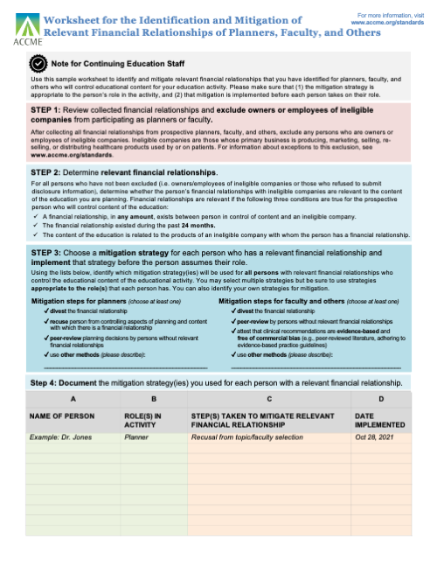
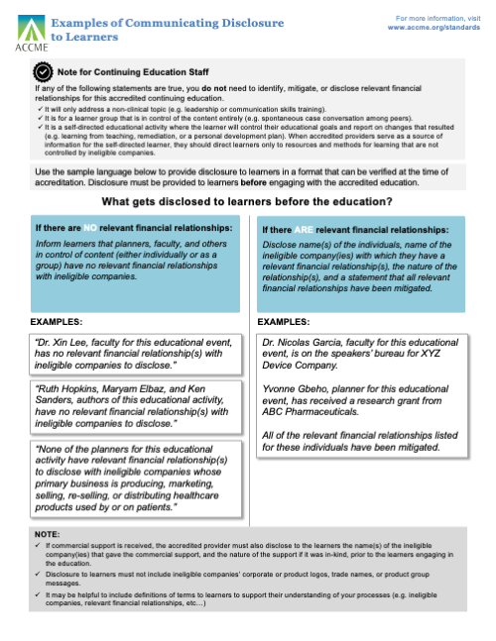
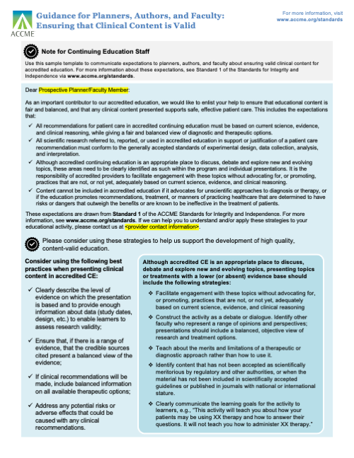
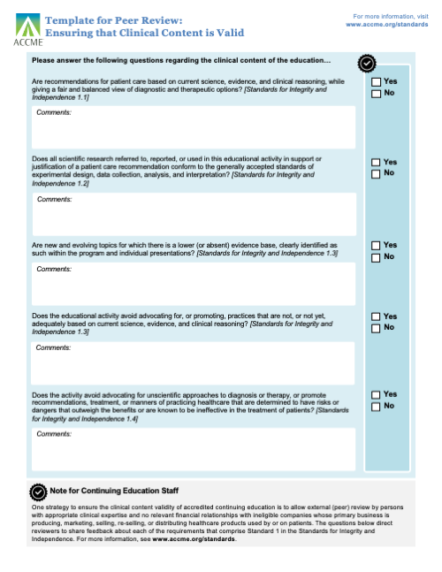
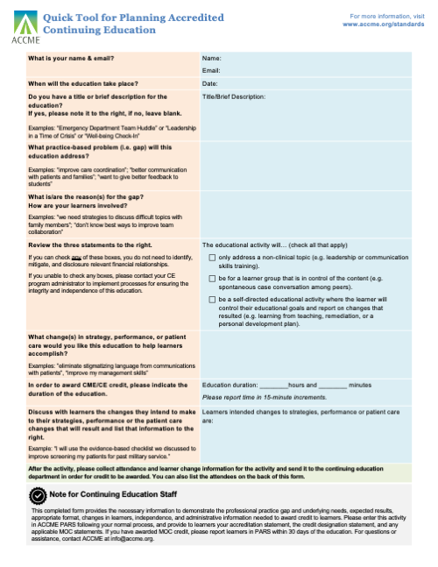
Toolkit for the Standards for Integrity and Independence in Continuing Education for Approved Providers
The ANCC is pleased to provide this toolkit of resources to assist the [AA org. name] approved providers in transitioning to the new Standards for Integrity and Independence. For this initial collection of tools, we have focused on Standard 1: Ensure Content is Valid and Standard 3: Identify, Mitigate, and Disclose Relevant Financial Relationships. These two standards are applicable to all approved providers. Implementation of the standards is not optional but use of these resources is completely optional. Many approved providers have their own policies, procedures, forms, and mechanisms to facilitate the planning and delivery of approved education—as you review your own practices, you may wish to check them against these resources to ensure you are positioned to meet the accreditation standards.
As always, we remain available for questions and assistance! Contact us at [AA org. name and contact information here]
Key Steps
Overview of the 3-step process to identify, mitigate, and disclose relevant financial relationships.
Sample Letter
Language you can use to explain to prospective planners and faculty why financial relationship information is collected.
Template
Compare your process or forms to this sample template to collect the right information about financial relationships.
Worksheet
Step-by-step process for identifying and mitigating relevant financial relationships.
Examples
Sample language that shows you how to communicate disclosure to learners.
Guidance
An example of how to enlist help from planners and faculty to ensure that clinical content is valid.
Template
An example of a tool to facilitate peer review to ensure that clinical content is valid.
Quick Tool
Use this sample tool to simplify educational planning when identification, mitigation, and disclosure are not required.
Adapted from the Toolkit for the Standards for Integrity and Independence in Accredited Continuing Education © 2020 by the Accreditation Council for Continuing Medical Education (ACCME®)
Page 1 of 9

Slide 2
Key Steps for the Identification, Mitigation, and Disclosure of Relevant Financial Relationships
Note for Primary Nurse Planner or Nurse Planner
If any of the following statements apply to the education, you do not need to identify, mitigate, or disclose relevant financial relationships for this approved continuing education:
It will only address a non-clinical topic (e.g., leadership or communication skills training).
It is for a learner group that is in control of the content entirely (e.g., spontaneous case conversation among peers).
It is a self-directed educational activity where the learner will control their educational goals and report on changes that resulted (e.g., personal development plan). When approved providers serve as a source of information for the self-directed learner, they should direct learners only to resources and methods for learning that are not controlled by ineligible companies.
STEP 1: Before you begin planning your education, collect information from all members of the planning committee, faculty, and others who would be in positions to control content. Ask them to provide information about all their financial relationships with ineligible companies over the previous 24 months. There is no minimum financial threshold; individuals must disclose all financial relationships, regardless of the amount, with ineligible companies.
Ensure you use this definition: Ineligible companies are those whose primary business is producing, marketing, selling, re-selling, or distributing healthcare products used by or on patients.
Hint: Use the Template for Collecting Information about All Financial Relationships from the Planning committee, Faculty, and Others.
STEP 2: Review all relationships and exclude owners and employees of ineligible companies from participating as planners, faculty, or other roles unless the educational activity meets one of the exceptions listed below.
If the exception(s) exists for members of the planning committee, and all faculty, and others who would be in positions to control content – go to step 3.
There are only three exceptions that allow for owners and/or employees of ineligible companies to participate as planners or faculty in approved continuing education.
When the content of the activity is not related to the business lines or products of their employer/company.
When the content of the approved activity is limited to basic science research, such as pre-clinical research and drug discovery, or the methodologies of research, and they do not make care recommendations.
When they are participating as technicians to teach the safe and proper use of medical devices, and do not recommend whether or when a device is used.
STEP 3: Determine which financial relationships are relevant to the content of the continuing education activity, mitigate those relevant financial relationships to prevent commercial bias, and disclose the presence or absence of all relevant financial relationships to learners prior to the activity.
A
Determine relevant financial relationships for all who will be in control of educational content.
Financial relationships are relevant if the following three conditions are met for the individual who will control content of the education:
A financial relationship, in any amount, exists between the person in control of content and an ineligible company.
The financial relationship existed during the past 24 months.
The content of the education is related to the products of an ineligible company with whom the person has a financial relationship.
B
Mitigate relevant financial relationships prior to individuals assuming their roles in the educational activity.
Hint: Use the Worksheet for the Identification and Mitigation of Relevant Financial Relationships of Planners, Faculty, and Others to implement mitigation strategies appropriate to their role(s) in the educational activity.
C
Before the learner engages in the education, disclose to learners the presence or absence of relevant financial relationships for all persons in control of content.
Hint: Use the Examples of Communicating Disclosure to Learners to share all of the appropriate information before the activity.
Adapted from the Toolkit for the Standards for Integrity and Independence in Accredited Continuing Education © 2020 by the Accreditation Council for Continuing Medical Education (ACCME®)
Page 2 of 9

Slide 3
OPTIONAL Sample Letter to Explain Why Financial Relationship Information is Collected
Note for Primary Nurse Planner or Nurse Planner
If any of the following statements apply to the education, you do not need to identify, mitigate, or disclose relevant financial relationships for this approved continuing education and the sample letter is NOT needed:
It will only address a non-clinical topic (e.g., leadership or communication skills training).
It is for a learner group that is in control of the content entirely (e.g., spontaneous case conversation among peers).
It is a self-directed educational activity where the learner will control their educational goals and report on changes that resulted (e.g., learning from teaching, remediation, or a personal development plan). When aapproved providers serve as a source of information for the self-directed learner, they should direct learners only to resources and methods for learning that are not controlled by ineligible companies.
At the beginning of your planning process, YOU MAY use the sample language below to communicate with prospective planners, faculty, and others who may be in control of content for the educational activity. It is important to identify financial relationships before activity planning begins so that relevant financial relationships can be mitigated in a manner that is appropriate to each person’s role.
Dear Prospective Planning Committee/Faculty Member:
We are looking forward to having the opportunity to include you as a <proposed role for person—e.g., planner, faculty, reviewer, etc.…> in the continuing education, <Insert activity title or working title and date/location information, if appropriate>.
Why am I receiving this communication? We appreciate your help in partnering with us to follow accreditation guidelines and help us create high-quality education that is independent of commercial interest/ineligible organization influence. In order to participate as a person who will be able to control the educational content of this approved CE activity, we ask that you disclose all financial relationships with any ineligible companies that you have had over the past 24 months. We define ineligible companies as those whose primary business is producing, marketing, selling, re-selling, or distributing healthcare products used by or on patients. There is no minimum financial threshold; you must disclose all financial relationships, regardless of the amount, with ineligible companies. We ask you to disclose regardless of whether you view the financial relationships as relevant to the education. For more information on the Standards for Integrity and Independence in Accredited Continuing Education, please visit accme.org/standards.
Why do we collect this information? Since healthcare professionals serve as the trusted authorities when advising patients, they must protect their learning environment from industry influence to ensure they remain true to their ethical commitments. Many healthcare professionals have financial relationships with ineligible companies. By identifying and mitigating relevant financial relationships, we work together to create a protected space to learn, teach, and engage in scientific discourse, free from influence from organizations that may have an incentive to insert commercial bias into education.
What are the next steps in this process? After we receive your disclosure information, we will review it to determine whether your financial relationships are relevant to the education. Please note: the identification of relevant financial relationships does not necessarily mean that you are unable to participate in the planning and implementation of this educational activity. Rather, the accreditation standards require that relevant financial relationships are mitigated before you assume your role in this activity.
To help us meet these expectations, please use the form we have provided to share all financial relationships you have had with ineligible companies during the past 24 months. This information is necessary in order for us to be able to move to the next steps in planning this continuing education activity.
If you have questions about these expectations, please contact us at <approved provider contact information>.
Adapted from the Toolkit for the Standards for Integrity and Independence in Accredited Continuing Education © 2020 by the Accreditation Council for Continuing Medical Education (ACCME®)
Page 3 of 9
Notes:
3

Slide 4
Template for Collecting Information about All Financial Relationships from Nurse Planners, Content Expert, Faculty, and Others
To be completed by Primary Nurse Planner or designee: Name of Individual /credentials Example Dr. Jones Phd, MSN, BSN ________________________________________________ Title of NCPD Activity: Care of IV sites ________________________________________________ Date and location of NCPD activity: June 30, 2021 ________________________________________________
Individual’s prospective role(s) in NCPD activity Identify the prospective role(s) that this person may have in the planning and delivery of this education (choose all that apply)
Primary Nurse Planner/Nurse Planner
Content Expert
Teacher, Instructor, Faculty
Author, Writer
Content Reviewer
Other _____________________________________________
X
As the nurse planner, content expert or faculty member or other, we ask for your help in protecting our learning environment from industry influence. Please complete the form below and return it to ______Contact Name/email________ by ____Date___. The Standards for Integrity and Independence require that we disqualify individuals who refuse to provide this information from involvement in the planning and implementation of approved continuing education. Thank you for your diligence and assistance. If you have questions, please contact us at ______Contact Name/email________.
To be Completed by Nurse Planner, Faculty, or Others Who May Control Educational Content Please disclose all financial relationships that you have had in the past 24 months with ineligible companies (see definition below). For each financial relationship, enter the name of the ineligible company and the nature of the financial relationship(s). There is no minimum financial threshold; we ask that you disclose all financial relationships, regardless of the amount, with ineligible companies. You should disclose all financial relationships regardless of the potential relevance of each relationship to the education.
Enter the Name of Ineligible Company An ineligible company is any entity whose primary business is producing, marketing, selling, re-selling, or distributing healthcare products used by or on patients. For specific examples of ineligible companies visit accme.org/standards. |  | Enter the Nature of Financial Relationship Examples of financial relationships include employee, researcher, consultant, advisor, speaker, independent contractor (including contracted research), royalties or patent beneficiary, executive role, and ownership interest. Individual stocks and stock options MUST be disclosed; diversified mutual funds do not need to be disclosed. Research funding from ineligible companies MUST be disclosed by the principal or named investigator even if that individual’s institution receives the research grant and manages the funds. |  | Has the Relationship Ended? If the financial relationship existed during the last 24 months, but has now ended, please check the box in this column. This will help the education staff determine if any mitigation steps need to be taken.
Example: IV Company |  | RN Research Coordinator and Educator
 | In the past 24 months, I have not had any financial relationships with any ineligible companies.
I attest that the above information is correct as of this date of submission. |  |  | Date
Note for Primary Nurse Planner or Nurse Planner
Use this template to collect all relevant financial relationships of prospective planners, faculty, and others who may control educational content before they assume their role in the education. As an alternative to collecting disclosure information for each activity, if your planners and faculty are a set group of individuals, you might choose to collect this information on an annual or periodic basis and ask the individuals to update if any information changes during the year.
Adapted from the Toolkit for the Standards for Integrity and Independence in Accredited Continuing Education © 2020 by the Accreditation Council for Continuing Medical Education (ACCME®)
Page 4 of 9

Slide 5
Worksheet for the Mitigation of Identified Relevant Financial Relationships of Nurse Planners, Faculty, and Others
Note for Primary Nurse Planner or Nurse Planner
Use this sample worksheet to identify and mitigate relevant financial relationships that you have identified for planners, faculty, and others who will control educational content for your education activity. Please make sure that (1) the mitigation strategy is appropriate to the person’s role in the activity, and (2) that mitigation is implemented before each person takes on their role.
STEP 1: Review collected information about financial relationships and exclude owners or employees of ineligible companies from participating as planners or faculty.
After collecting all financial relationships from prospective planners, faculty, and others, exclude any persons who are owners or employees of ineligible companies. Ineligible companies are those whose primary business is producing, marketing, selling, re-selling, or distributing healthcare products used by or on patients.
For information about exceptions to this exclusion, refer to page 2, step 2 for exceptions or the accme.org/standards.
STEP 2: Determine relevant financial relationships.
Review the information for all persons not excluded in Step 1 and determine whether each person’s financial relationships with ineligible companies are relevant to the content of the education you are planning. Financial relationships are relevant if the following three conditions are met for the prospective person who will control content of the education:
A financial relationship, in any amount, exists between the person in control of content and an ineligible company.
The financial relationship existed during the past 24 months.
The content of the education is related to the products of an ineligible company with whom the person has a financial relationship.
STEP 3: Choose a mitigation strategy for each person who has a relevant financial relationship and implement that strategy before the person assumes their role.
Using the lists below, identify which mitigation strategy(ies) will be used for all persons with relevant financial relationships who control the educational content of the educational activity. You may select multiple strategies but be sure to use strategies appropriate to the role(s) that each person has. You can also identify your own strategies for mitigation.
Mitigation steps for planners (choose at least one)
✓ Divest the financial relationship
✓ Recusal from controlling aspects of planning and content with which there is a financial relationship
✓ Peer review of planning decisions by persons without relevant financial relationships
✓ Use other methods – make sure you describe the method
Mitigation steps for faculty and others (choose at least one)
✓ Divest the financial relationship
✓ Peer review of content by persons without relevant financial relationships
✓ Attest that clinical recommendations are evidence-based and free of commercial bias (e.g., peer-reviewed literature, adhering to evidence-based practice guidelines)
✓ Use other methods – make sure you describe the method
Step 4: Document the mitigation strategy(ies) you used for each person with a relevant financial relationship.
A | B | C | D
NAME OF PERSON | ROLE(S) IN ACTIVITY | STEP(S) TAKEN TO MITIGATE RELEVANT FINANCIAL RELATIONSHIP | DATE IMPLEMENTED
Example: Dr. Jones Phd, MSN, BSN | Planning Committee member / speaker | Peer review of content by persons without relevant financial relationships | June 1, 2021
Adapted from the Toolkit for the Standards for Integrity and Independence in Accredited Continuing Education © 2020 by the Accreditation Council for Continuing Medical Education (ACCME®)
Page 5 of 9

Slide 6
Examples of Communicating Disclosure to Learners
Note for Primary Nurse Planner or Nurse Planner
If any of the following statements apply to the education, you do not need to identify, mitigate, or disclose relevant financial relationships for this approved continuing education:
It will only address a non-clinical topic (e.g., leadership or communication skills training).
It is for a learner group that is in control of the content entirely (e.g., spontaneous case conversation among peers).
It is a self-directed educational activity where the learner will control their educational goals and report on changes that resulted (e.g., learning from teaching, remediation, or a personal development plan). When approved providers serve as a source of information for the self-directed learner, they should direct learners only to resources and methods for learning that are not controlled by ineligible companies.
You may use the sample language below as evidence of information disclosed to learners in the activity file. Disclosure must be provided to learners before engaging with the approved education.
What gets disclosed to learners before the educational activity?
If there are NO relevant financial relationships:
Inform learners that nurse planners, content experts’, faculty, and others in control of content (either individually or as a group) have no relevant financial relationships with ineligible companies.
Remember that you do not need to make disclosures for the 3 exceptions noted above
If there ARE relevant financial relationships:
Disclose name(s) of the individuals, name of the ineligible company(ies) with which they have a relevant financial relationship(s), the nature of the relationship(s), and a statement that all relevant financial relationships have been mitigated.
EXAMPLES:
EXAMPLES:
“Dr. Xin Lee FNP, faculty for this educational event, has no relevant financial relationship(s) with ineligible companies to disclose.”
Nicolas Garcia, faculty for this educational event, is on the speakers’ bureau for XYZ Device Company.
Dr. Yvonne Gbeho, nurse planner for this educational event, has received a research grant from ABC Pharmaceuticals.
All of the relevant financial relationships listed for these individuals have been mitigated.
“Ruth Hopkins, Dr. Maryam Elbaz, and Ken Sanders, authors of this educational activity, have no relevant financial relationship(s) with ineligible companies to disclose.”
“None of the planning committee for this educational activity have relevant financial relationship(s) to disclose with ineligible companies whose primary business is producing, marketing, selling, re-selling, or distributing healthcare products used by or on patients.”
NOTE:
If commercial support is received, the approved provider must also disclose to the learners the name(s) of the ineligible company(ies) that gave the commercial support, and the nature of the support if it was in-kind, prior to the learners engaging in the education.
Disclosure to learners must not include ineligible companies’ corporate or product logos, trade names, or product group messages.
It may be helpful to include definitions of terms to learners to support their understanding of your processes (e.g., ineligible companies, relevant financial relationships, etc…)
Adapted from the Toolkit for the Standards for Integrity and Independence in Accredited Continuing Education © 2020 by the Accreditation Council for Continuing Medical Education (ACCME®)
Page 6 of 9

Slide 7
OPTIONAL: Guidance for Nurse Planners, Authors, and Faculty: Ensuring that Clinical Content is Valid
Note for Primary Nurse Planner or Nurse Planner
Use this sample template to communicate expectations to content experts, authors, and speakers/faculty about ensuring valid clinical content for approved education. For more information about these expectations, see Standard 1 of the Standards for Integrity and Independence at accme.org/standards.
Dear Prospective Planning Committee/Faculty Member:
As an important contributor to our approved education, we would like to enlist your help to ensure that educational content is fair and balanced, and that any clinical content presented supports safe, effective patient care. This includes the expectations that:
All recommendations for patient care in approved continuing education must be based on current science, evidence, and clinical reasoning, while giving a fair and balanced view of diagnostic and therapeutic options.
All scientific research referred to, reported, or used in approved education in support or justification of a patient care recommendation must conform to the generally accepted standards of experimental design, data collection, analysis, and interpretation.
Although approved continuing education is an appropriate place to discuss, debate, and explore new and evolving topics, these areas need to be clearly identified as such within the program and individual presentations. It is the responsibility of approved providers to facilitate engagement with these topics without advocating for, or promoting, practices that are not, or not yet adequately based on current science, evidence, and clinical reasoning.
Content cannot be included in approved education if it advocates for unscientific approaches to diagnosis or therapy, or if the education promotes recommendations, treatment, or manners of practicing healthcare that are determined to have risks or dangers that outweigh the benefits or are known to be ineffective in the treatment of patients.
These expectations are drawn from Standard 1 of the Standards for Integrity and Independence in Accredited Continuing Education. For more information, see accme.org/standards. If we can help you to understand and/or apply these strategies to your education, please contact us at <approved provider contact information>.
Please consider using these strategies to help us support the development of valid, relevant high-quality education.
Consider using the following best practices when presenting clinical content in approved CE:
Clearly describe the level of evidence on which the presentation is based and provide enough information about data (study dates, design, etc.) to enable learners to assess research validity.
Ensure that, if there is a range of evidence, that the credible sources cited present a balanced view of the evidence.
If clinical recommendations will be made, include balanced information on all available and relevant therapeutic options.
Address any potential risks or adverse effects that could be caused with any clinical recommendations.
Although approved CE is an appropriate place to discuss, debate, and explore new and evolving topics, presenting topics or treatments with a lower (or absent) evidence base should include the following strategies:
Facilitate engagement with these topics without advocating for, or promoting, practices that are not, or not yet adequately based on current science, evidence, and clinical reasoning
Construct the activity as a debate or dialogue. Identify other faculty who represent a range of opinions and perspectives; presentations should include a balanced, objective view of research and treatment options.
Teach about the merits and limitations of a therapeutic or diagnostic approach rather than how to use it.
Identify content that has not been accepted as scientifically meritorious by regulatory and other authorities, or when the material has not been included in scientifically accepted guidelines or published in journals with national or international stature.
Clearly communicate the learning outcomes for the activity to learners (e.g., “This activity will teach you about how your patients may be using XX therapy and how to answer their questions. It will not teach you how to administer XX therapy”).
Adapted from the Toolkit for the Standards for Integrity and Independence in Accredited Continuing Education © 2020 by the Accreditation Council for Continuing Medical Education (ACCME®)
Page 7 of 9

Slide 8
OPTIONAL: Template for Peer Review or Content Review: Ensuring that Clinical Content is Valid
Note: Planning Committee must have a Nurse Planner and a Content Expert.
Please answer the following questions regarding the clinical content of the education.
Are recommendations for patient care based on current science, evidence, and clinical reasoning, while giving a fair and balanced view of diagnostic and therapeutic options? [Standards for Integrity and Independence 1.1]
Yes
No
Comments:
Does all scientific research referred to, reported, or used in this educational activity in support or justification of a patient care recommendation conform to the generally accepted standards of experimental design, data collection, analysis, and interpretation? [Standards for Integrity and Independence 1.2]
Yes
No
Comments:
Are new and evolving topics for which there is a lower (or absent) evidence base, clearly identified as such within the education and individual presentations? [Standards for Integrity and Independence 1.3]
Yes
No
Comments:
Does the educational activity avoid advocating for, or promoting, practices that are not, or not yet, adequately based on current science, evidence, and clinical reasoning? [Standards for Integrity and Independence 1.3]
Yes
No
Comments:
Does the activity exclude any advocacy for, or promotion of, unscientific approaches to diagnosis or therapy, or recommendations, treatment, or manners of practicing healthcare that are determined to have risks or dangers that outweigh the benefits or are known to be ineffective in the treatment of patients? [Standards for Integrity and Independence 1.4]
Yes
No
Comments:
Note for Primary Nurse Planner or Nurse Planner
One strategy to ensure the clinical content validity of approved continuing education is to allow external (peer) review by persons with appropriate clinical expertise and no relevant financial relationships with ineligible companies, defined as those whose primary business is producing, marketing, selling, re-selling, or distributing healthcare products used by or on patients. The questions above direct reviewers to share feedback about each of the requirements that comprise Standard 1 in the Standards for Integrity and Independence. For more information, see accme.org/standards.
Adapted from the Toolkit for the Standards for Integrity and Independence in Accredited Continuing Education © 2020 by the Accreditation Council for Continuing Medical Education (ACCME®)
Page 8 of 8

