Slide 1
The use of Social media to promote professionalism and enhance nursing practice
DONNA REINBECK, MSN, OCN, NEA-BC
JACLYN ANTONACCI, MA

Slide 2
A bit about us…
Donna Reinbeck
Graduate Coordinator at Kean University at Ocean
PhD Student
Previously: Director of Oncology, 15+ years in nursing leadership
Jaclyn Antonacci
Social Media Coordinator at William Paterson University
M.A. in Digital Marketing
The product of a nurse!
Notes:
https://www.google.com/search?q=jaclyn+antonacci&oq=jaclyn+antonacci&aqs=chrome..69i57j69i60j69i65l2j69i60j69i61.3311j0j7&sourceid=chrome&es_sm=119&ie=UTF-8

Slide 3
Social Media
Websites and applications that enable users to create and share content or participate in social networking.

Slide 4
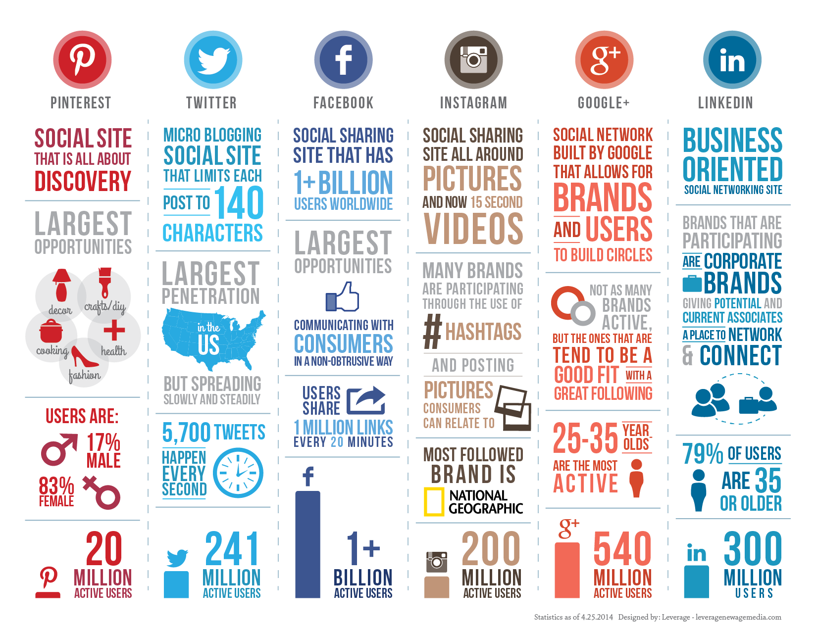

Slide 5
Personal Branding
The process by which individuals differentiate themselves by identifying and articulating their unique value proposition and then leveraging it across platforms with a consistent message and image to achieve a specific goal
How we market ourselves to others

Slide 6
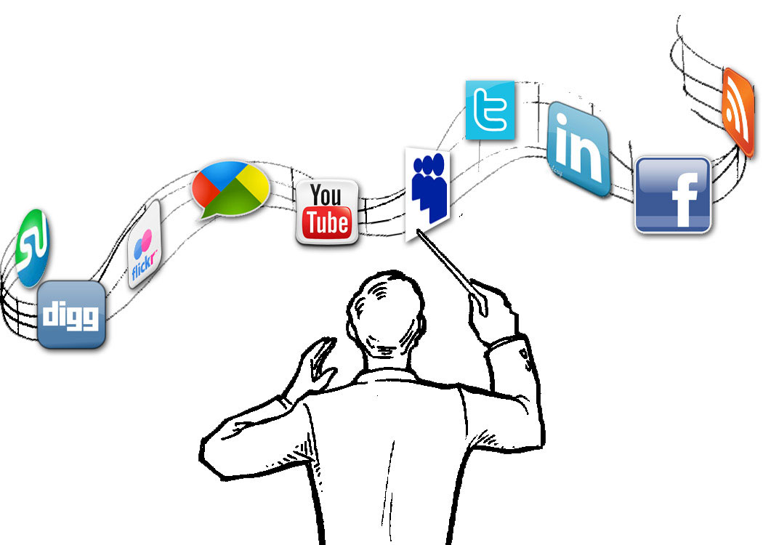
Digital Identity
Our online presence built by posts, uploads, tweets, photos, videos, and other online contributions. Digital Identity is how we engage, share, promote, and present ourselves online.

Slide 7
Developing a digital personal brand can help you:
In your current job
In your career search
Find new opportunities / partnerships
Build rapport
Make connections
Grow your network

Slide 8
Things to think about before building a purposeful online presence:
Who do I stand for?
What are my goals?
What are my values?
What are my passions?
What are my strengths?
Where would I like to be in 3 years?
What is my ideal job?

Slide 9
Why is social media important?

Slide 10
Digital Identity
What did you find?
Search Engine Optimization
Here’s my Google Search.
http://www.google.com/webmaster/tools/removals
Notes:
https://www.google.com/search?q=jaclyn+antonacci&oq=jaclyn+antonacci&aqs=chrome..69i57j69i60j69i65l2j69i60j69i61.3311j0j7&sourceid=chrome&es_sm=119&ie=UTF-8

Slide 11
Use social media purposefully
Check your organizations’ social media policies
Things to avoid:
Unprofessional behavior of all kinds
Posting rude or disparaging remarks
Sharing confidential or sensitive information
Disclosing patient information of any kind
“Friending” patients on social media
Commenting on behalf of your organization
Be extra wary when posting photos or other multimedia

Slide 12
About Twitter
Users can create short, 140-character messages called “Tweets”
To see another user’s tweets, you can “follow” them. This is similar to “friending” someone on Facebook.
Similar to Facebook, a Twitter user has a “feed” where they see posts from people they follow.
Users can share tweets to their own page by “retweeting”
Hashtags offer users a way to categorize their tweets and join global conversations *

Slide 13
Creating a Twitter Bio
Your Twitter bio should reflect who you are, your values, and what you have to offer
Your bio is your first impression
160 characters, so be concise!
Perfect spelling and grammar
Make clear exactly what it is that you do
Position yourself as an expert in your field
Why should someone follow you?

Slide 14
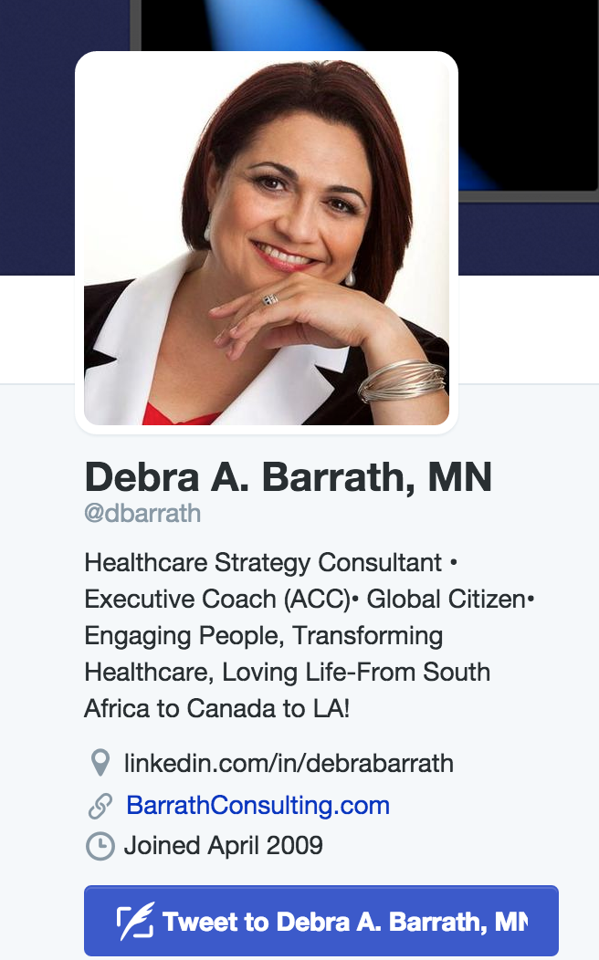
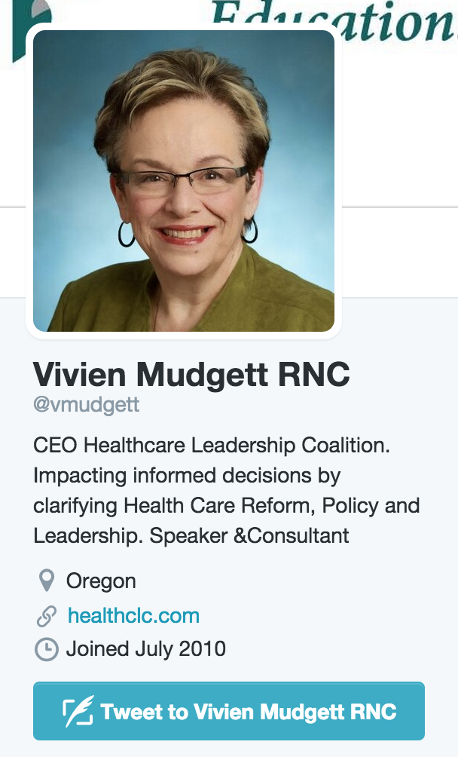
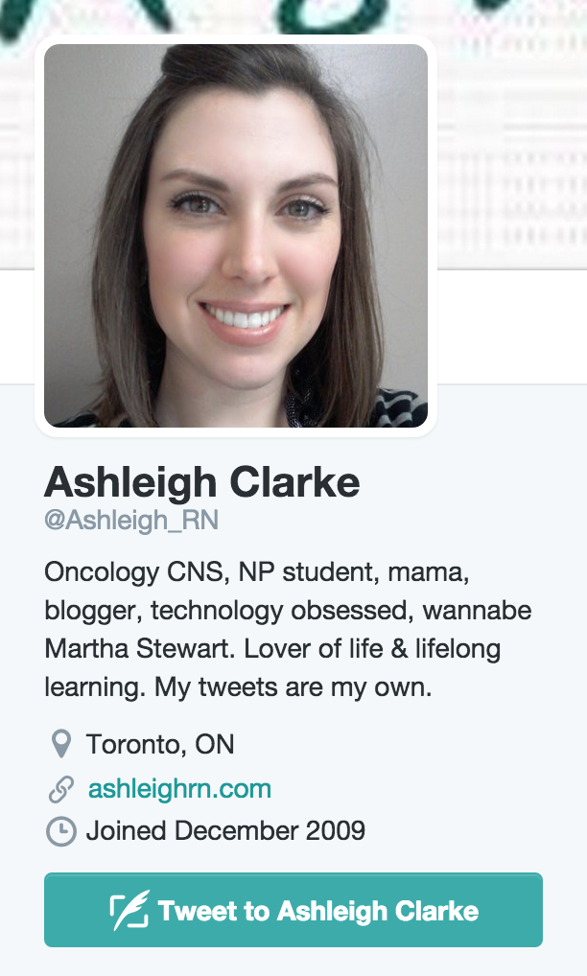
Some example bios:
Notes:
https://www.google.com/search?q=jaclyn+antonacci&oq=jaclyn+antonacci&aqs=chrome..69i57j69i60j69i65l2j69i60j69i61.3311j0j7&sourceid=chrome&es_sm=119&ie=UTF-8

Slide 15
Accounts to follow:
New Jersey State Nurses Association - @NJNurses
American Nurses Association- @ANANursingWorld
AtlantiCare - @AntlantiCareNJ
Meridian Health System - @MeridianNJ
Barnabas Health System - @Barnabas_Health
American Journal of Nursing - @AmJNurs
Robert Wood Johnson Foundation - @RWJF
The Centers for Disease Control & Prevention - @CDCgov
Oncology Nursing Society - @OncologyNursing

Slide 16
Twitter Hashtags
A hashtag (#) is community-driven word or phrase used to identify or label tweets on a specific topic or event.
Can be used for events, conferences, places, people, or general topics
Including a hashtag in your Tweet is a great way to give your Tweet more exposure
Similarly, searching through a hashtag (i.e.: #nursing) is a great way to find relevant users to follow

Slide 17
Remember this?
Miss Colorado’s 2015 Speech
The View
#NursesUnite
#NursesShareYourStethoscopes

Slide 18
Could you contribute to any of these local or global conversations?
#KeanUniversity
#NJNurses
#AdviceForNewNurses
#HealthcareTips
#ArtOfNursing
#FutureOfNursing
#CelebrateNurses

Slide 19
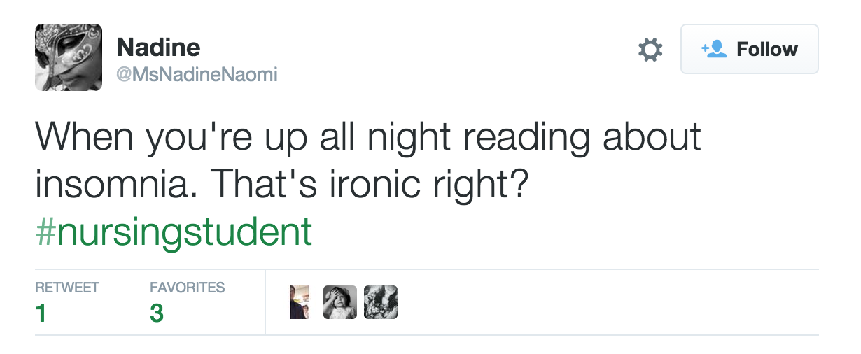
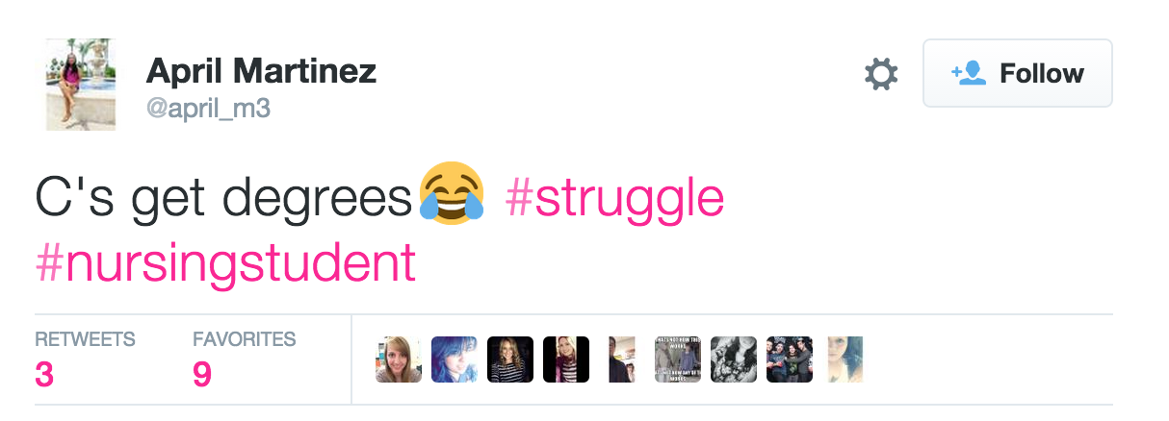
#NursingStudent

Slide 20
Tips for Tweeting
Be authentic
Keep audience in mind
Think before you Tweet, your posts could be seen by:
Your friends, your family, your professors, your community, journalists, current employers, potential future employers
Think about context and perception
Find a balance between personal and professional posts
Spelling and grammar are still essential

Slide 21
LinkedIn
World’s largest professional network
Ranks high in Google searches
Has 227 million members
Used by recruiters

Slide 22
LinkedIn – Completing your profile
Complete your profile and keep it updated with the most up-to-date professional information
Add keywords to your professional headline and in your summary
Mention the tools, software, and concepts you have experience with (Hint: You know Twitter now!)
Share links, industry news, your own work, etc.

Slide 23
LinkedIn – Build your network
Customize your message when adding people
Keep an eye on who is looking at your profile
Leave recommendations and endorsements for people you’ve worked with
Use the search function to find people, organizations and groups to follow
Here’s where you can find relevant groups: https://www.linkedin.com/groups/discover

Slide 24
ResearchGate
Communicate with researchers around the world
“Facebook for science”
Post your own research
Build your network
Q&A forum with industry experts.
Follow publications and research topics

Slide 25
Becoming Thought Leaders
Go-to people in a field of expertise. Trusted sources who move and inspire with innovative ideas; turn ideas into reality, and know and show how to replicate their success.
Create a lot of content
Use your social media to amplify new thoughts and ideas
Leverage your academic and professional experience

Slide 26
Avoiding Social Media Pitfalls
Review the social media policy at your place of employment
Posts from private accounts can still be shared
Maintain professionalism and composure at all times
You should never:
Complain about/comment on patients
Post photographs or videos of patients (even with consent)
Rant about your place of employment
Use offensive language/create or share offensive posts

Slide 27
Additional Resources - Apps
Medscape WebMD – Offers access to medical news stories
Disease Dictionary – Detailed information on medical diseases
Epocrates – Drug guide with pill interaction information
Black’s Medical Dictionary – Digital version of the reference guide
Pill Identifier – Search features to for pills without a label
MediBabble Translator – Helps with translation when working with non-English speakers

Slide 28
Questions?

Slide 29
Connect with me!
Web: www.JaclynAntonacci.com
Email: JaclynAntonacci@gmail.com
Facebook: www.facebook.com/jaclynantonacci
LinkedIn: www.linkedin.com/in/jaclynantonacci
Twitter: www.twitter.com/jaclynantonacci

