Slide 1
HEALTH CARE AT A TURNING POINT—SEIZING THE OPPORTUNITY
Ernest Grant, PhD, RN, FAAN
Vice President, American Nurses Association
October 13, 2016
New Jersey Nurses Association

Slide 2

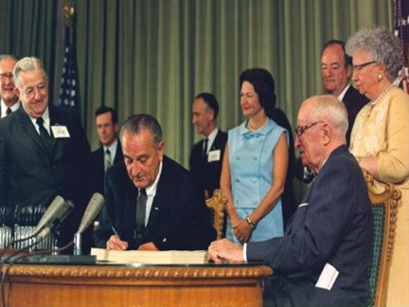
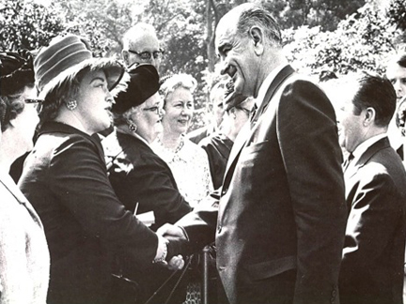
Major U.S. Health Care Reform: 1965
Notes:
2

Slide 3

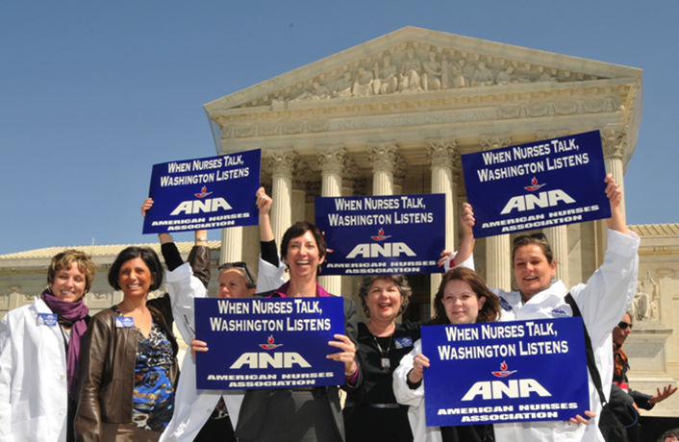

Championing the Affordable Care Act
2010
2012
2015

Slide 4
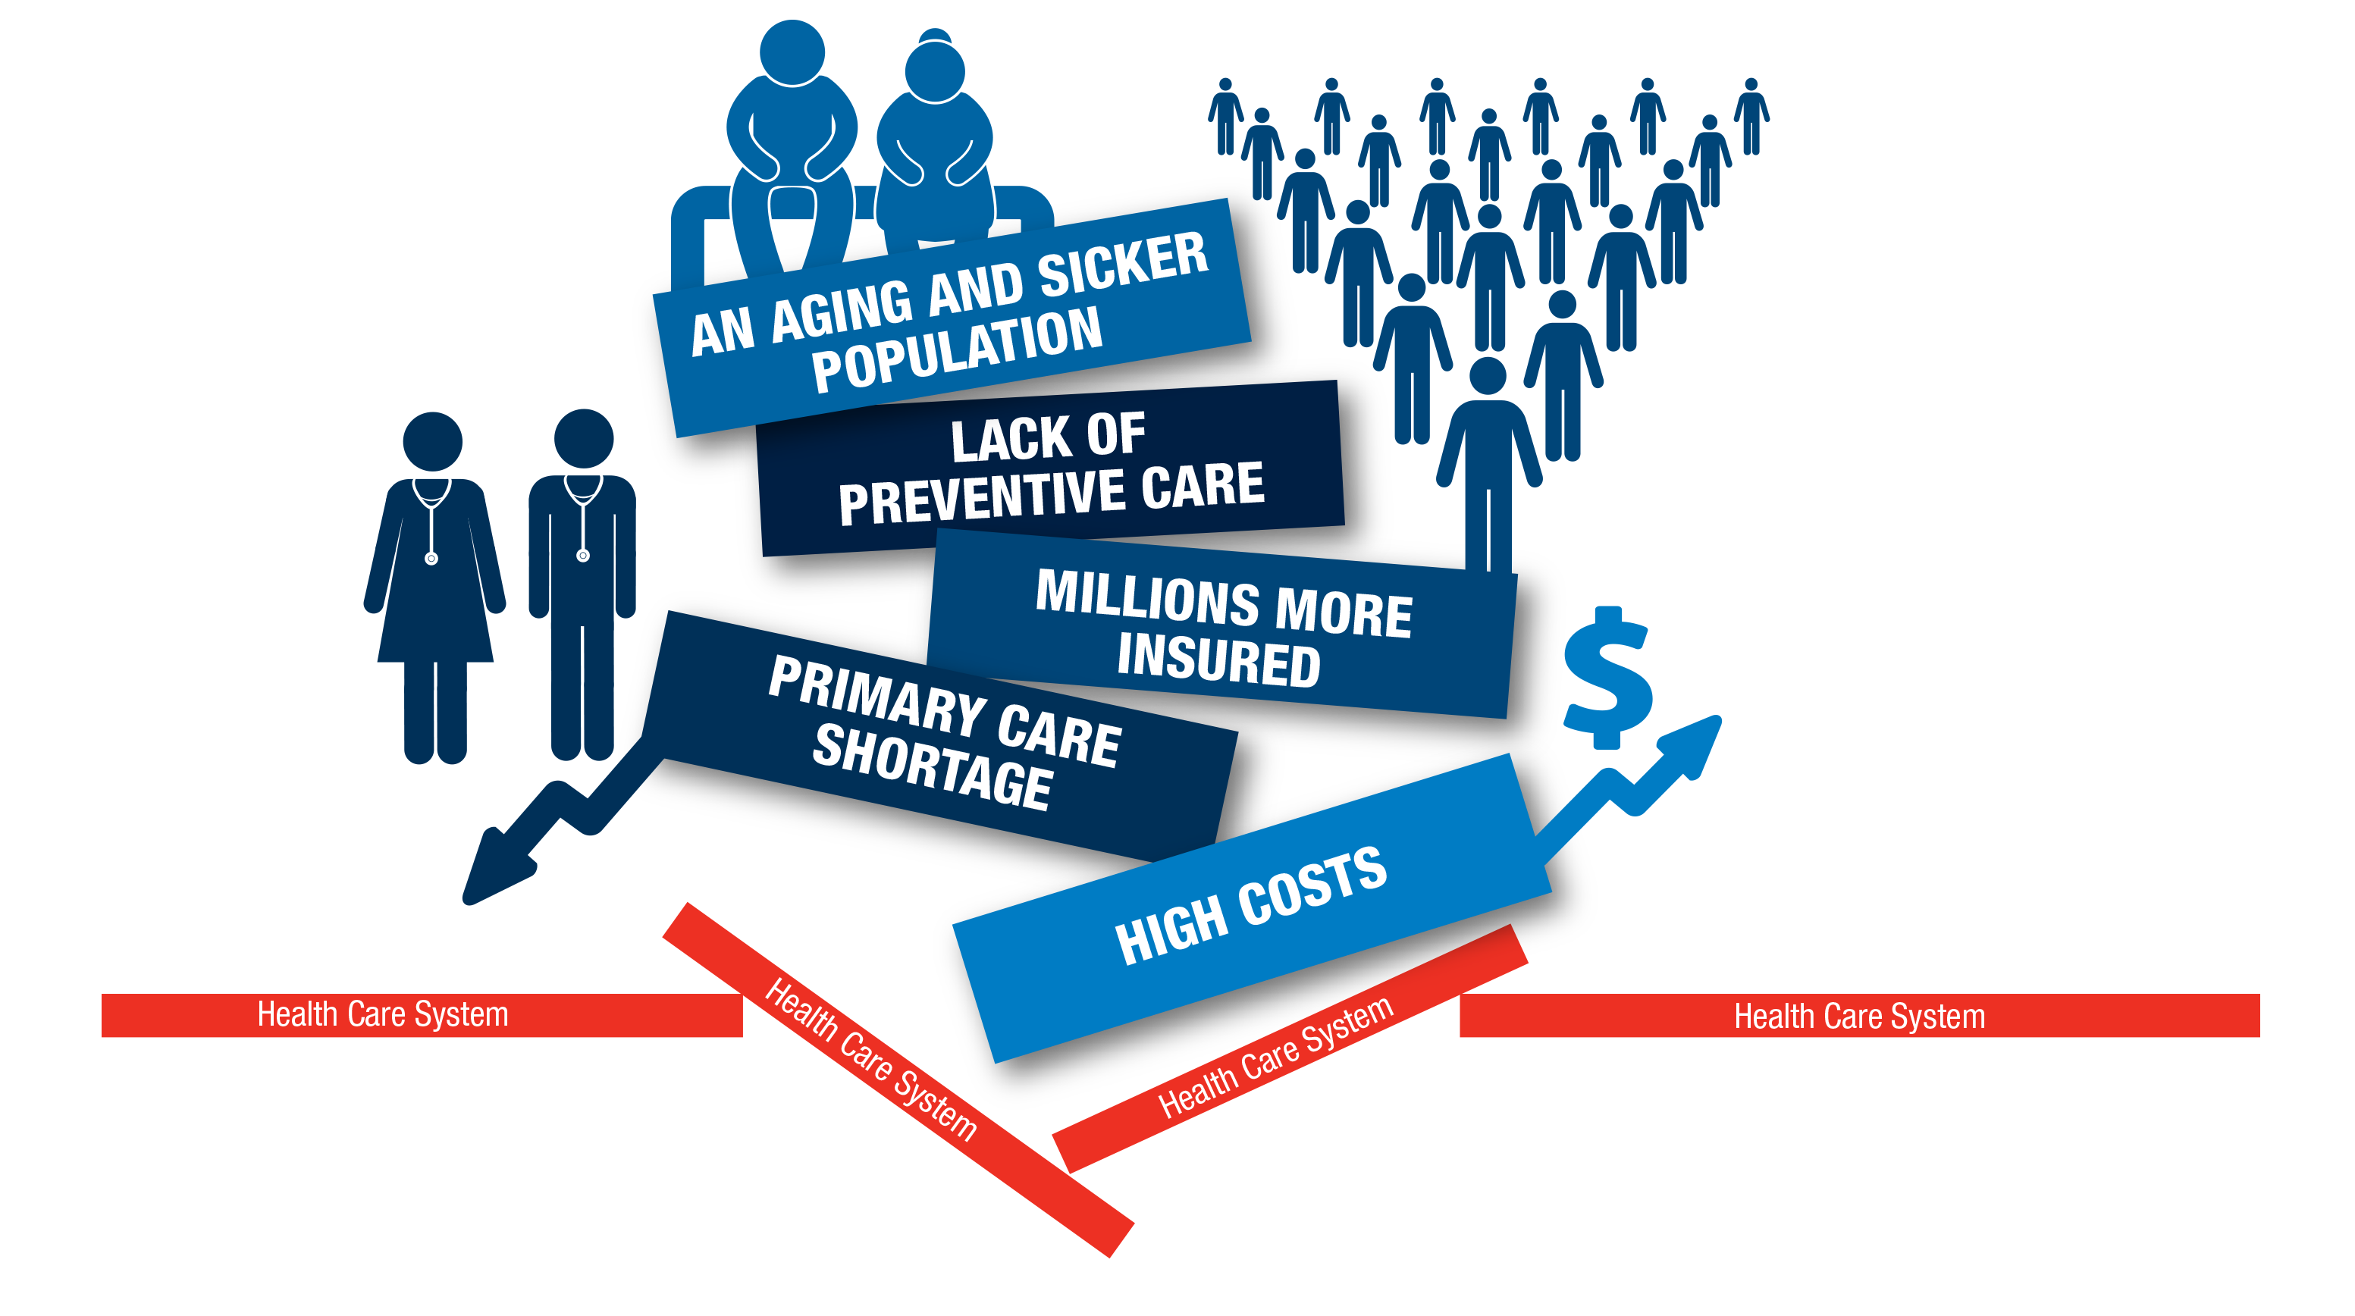
Health Care System Challenges

Slide 5


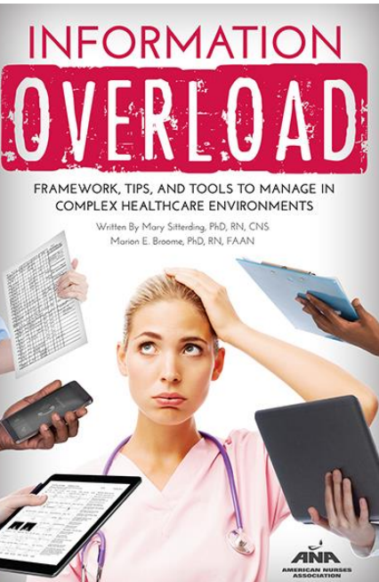

Nursing Competencies Needed in a
Care-Coordination, Scalable-Information Environment
BIG
DATA
CARE
COORDINATION
RAPID INFO PROCESSING
NursesBooks.org

Slide 6


Major Goals of the Affordable Care Act
EXPANDED COVERAGE
CARE DELIVERY REFORM
COST REFORM
INSURANCE REFORM
QUALITY REFORM
WELLNESS & PREVENTION
Notes:
6

Slide 7

A Better Future for New Jersey
11% UNINSURED
  20.4 HIV DIAGNOSIS RATE PER 100,000
  $2,482: HOSPITAL- ADJUSTED EXPENSES PER INPATIENT DAY
StateHealthFacts.org

Slide 8
What’s Happening with Nursing
in Health Care Reform
Workforce

Slide 9

Nursing Workforce Data
IOM Recommendation:
Build infrastructure
for collection and
analysis of
interprofessional
health care
workforce data
NEW JERSEY
Nurse Education Program Data
Nurse Supply Data
? Nurse Demand Data
Sources: The National Forum of State Nursing Workforce Centers
Philip R. Lee Institute for Health Policy Studies.
Notes:
9

Slide 10

NursingWorld.com/NBN

Slide 11

Diversity in the
Nursing Profession
FEMALE
MALE
IOM Recommendation:
Make diversity
in the nursing
workforce
a priority
U.S.
50.8%
49.2%
BSN &
graduate
nursing
students
88%
12%
Sources: AACN; U.S. Census Bureau, Population Division

Slide 12
Diversity in the
Nursing Profession
Employed Nurses' Racial and Ethnic Backgrounds vs.
U.S. Employed Population
EMPLOYED RNs OVER 60
EMPLOYED RNs UNDER 40
U.S. EMPLOYED POPULATION
81%
72%
68%
11%
10%
14%
9%
11%
7%
5%
3%
6%
1%
2%
2%
WHITE
AFRICAN
AMERICAN
ASIAN
HISPANIC
ALL
OTHER

Slide 13

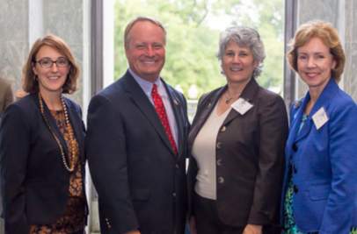
ANA Advocacy on
Nursing Workforce Development Programs
RNaction.org

Slide 14
What’s Happening with Nursing
in Health Care Reform
Scope of Practice

Slide 15
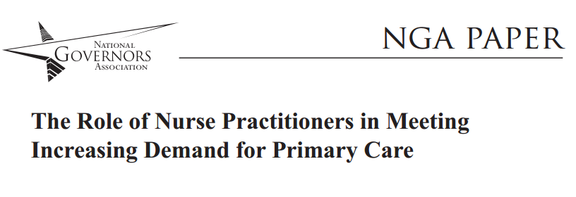

Utilizing APRNs to their Full Scope of Practice
nga.org
ftc.gov

Slide 16

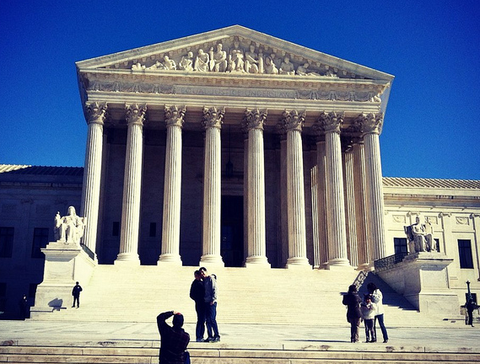

What SCOTUS Ruling on Dentistry Means for APRNs
—March 20, 2015

Slide 17


VA: Advancing APRN Full Practice Authority
#APRNs4Vets
The VA Rule on APRNs Should
Not Be Doctors vs. Nurses

Slide 18
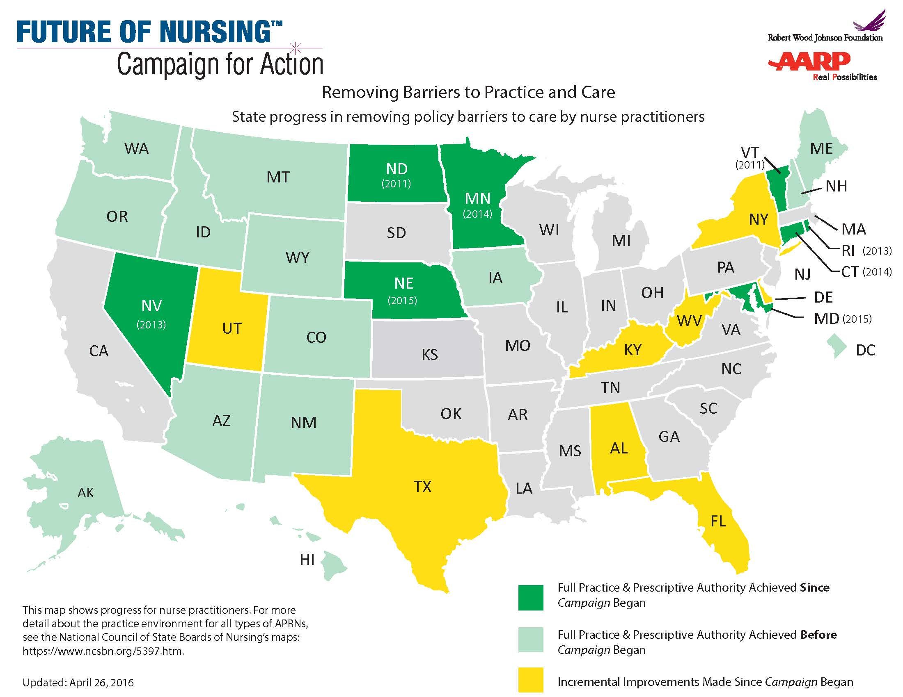
Removing Barriers to Practice and Care
Source: Center to Champion Nursing in America

Slide 19


RN Scope of Practice Work
SCOPE
OF
PRACTICE

Slide 20
What’s Happening with Nursing
in Health Care Reform
Leadership

Slide 21

NURSES ACCOUNT FOR ONLY
5 PERCENT
OF HOSPITAL BOARD POSITIONS
Source: AHA Center for Healthcare Governance
Notes:
21

Slide 22

Getting Nurses “At the Table”

Slide 23






Advancing Nurse Leadership
40+ RNs Appointed to
Key Roles IN LAST YEAR:

Slide 24

Be Counted!
NursesOnBoardsCoalition.org

Slide 25

ANA-LeadershipInstitute.org
Competency-based model
Relevant and timely content
A variety of programs to fit your schedule and needs
Notes:
25

Slide 26
What’s Happening with Nursing
in Health Care Reform
Quality

Slide 27

What is the Desired
Future We Seek?
Better health
Better care
Reduced cost

Slide 28
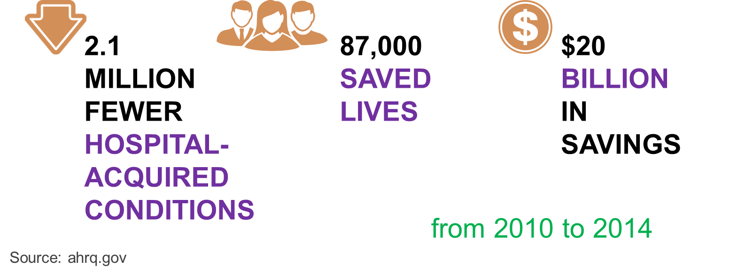
National Patient Safety Efforts Bearing Fruit

Slide 29
  How do we increase the
  QUALITY OF CARE
  while simultaneously
  REDUCING COSTS?

Slide 30
ANA: LEADING THE WAY
TO THE FUTURE OF HEALTH CARE

Slide 31


2016: Culture of Safety
Researchers:
Medical errors now third leading cause of death in U.S.

Slide 32




Taking on New Health Care Issues

Slide 33



Leading the Quadruple Aim
INCIVILITY, BULLYING & WORKPLACE VIOLENCE
Better Health
Better
Health Care
Lower Cost
SAFE PATIENT HANDLING
& MOBILITY
RN
RN
HEALTHY NURSE

Slide 34

ANA’s 2017-2020 Vision
All nurses as a POWERFUL UNIFIED
force in ENGAGING CONSUMERS & TRANSFORMING HEALTH
& HEALTH CARE

Slide 35
ANA’s 2017-2020 Strategic Goals
1
RN PROFESSION-WIDE ENGAGEMENT:
Increased number & engagement of nurses with ANA
2
NURSE-FOCUSED INNOVATION:
Innovation for health care improvement
3
NURSE-TO-CONSUMER RELATIONSHIPS:
Nursing as an integral partner in consumers’ health
& health care journey

Slide 36

2017 Sneak Peek…

Slide 37

Nursing Practice is Changing
SO ARE WE.

Slide 38

DISCUSSION
@ANANursingWorld

