Slide 1
COPD: An Update on Practice Changes for RNs & ANPs
Dr. Molly J. Bradshaw DNP, APN, FNP-BC, WHNP-BC
Rutgers School of Nursing

Slide 2
Introduction: Dr. Molly J. Bradshaw DNP, APN, FNP-BC, WHNP-BC Rutgers School of Nursing
The purpose of this presentation is to update RNs and APNs on the latest evidence regarding care of patients with Chronic Obstructive Pulmonary Disease (COPD).
Objectives:
Reinforce the Public Health Strategic Framework for COPD
Review updates in the Global Obstructive Lung Disease (GOLD) 2016 Guidelines
Introduce the new COPD Action Plan from the American Lung Association
Review key non-pharmacologic and pharmacologic considerations
Describe Asthma-COPD (ACOS) Overlap Syndrome

Slide 3
Definition
“COPD is a common preventable and treatable disease, characterized by persistent airflow limitation that is usually progressive and associated with enhanced chronic inflammatory responses in the airways.” (GOLD, 2016)
3rd leading cause of preventable death (CDC, 2011)
50% of those with COPD are unaware of Dx (CDC, 2011)
GOLD Guidelines: 2016 (GOLD, 2016)

Slide 4
Burden of Disease: US
12 million Americans are diagnosed with COPD
13.5 million Americans remain undiagnosed
Historically higher mortality = Men & African American
Incidence rate increasing faster = Women & Caucasian
ED Visits for COPD = higher in Women
Now, Women die more frequently than Men with COPD
75% of cases attributed to smoking
15% of cases attributed to genetics, asthma, exposure

Slide 5
COPD: “Lived Experience”
36% of Pts with mild-mod symptoms, can’t leave home
On average, the patient’s have 3 exacerbations/year
Predictive Factors of exacerbation not understood
Exacerbations will:
Accelerate the severity of the disease
Contribute to irreversible decline of lung function
Negative impact on quality of life
Decrease survival
Acute Exacerbation Treatment Failure: 20-40%
(Jones, Watz, Wouters, & Cazzola, 2016; Montserrat-Capdevila, J., et al., 2015)

Slide 6
QI: Accountable Care
ACO #9
Prevention Quality Indicator (PQI): Ambulatory Sensitive Conditions Admissions for Chronic Obstructive Pulmonary Disease (COPD) or Asthma in Older Adults
Guidelines have been established and should be followed
COPD and Asthma should be managed OUTPATIENT
Low income zip codes 5.8 times higher ED utilization rates for exacerbations in both conditions
(CMS, 2012)

Slide 7
Public Health Strategic Framework for COPD Prevention
Goals:
1) surveillance and education
Meet Healthy People 2020 Objectives:
- reduce activity limitations
- reduce death
- reduce hospitalizations
- improve lung function
2) public health research and prevention strategies
3) programs and polices
4) communication
(CDC, 2015)

Slide 8
NIH: Funding Priorities

Slide 9
COPD Needs Champions
RNs
APNs

Slide 10
Guideline Update: GOLD 2016
“COPD is a common preventable and treatable disease, characterized by persistent airflow limitation that is usually progressive and associated with enhanced chronic inflammatory responses in the airways.” (GOLD, 2016)
Points to Consider:
17 years for evidence translation to practice (White, et al., 2016)
IOM FON Report = Need Nurses w/Advanced Degrees

Slide 11
“persistent airflow limitation”

Slide 12
Correct Terminology
The revised GOLD Guidelines (2014) specifically pointed out correct use of the terms chronic bronchitis and emphysema.
Chronic Bronchitis: presence of cough and sputum production for at least 3 months in each year for 2 years, but it is NOT necessarily associated with airflow limitation.
Emphysema: defined as destruction of alveoli,
describes one of several structural abnormalities
of COPD. Can also be present normally.

Slide 13
Diagnosis of COPD
Clinical diagnosis of COPD should be considered if:
-dyspnea
-chronic cough
-sputum production
-history of exposure to risk factors
Spirometer is REQUIRED to make the dx of COPD:
1) Does the airflow limitation exist?
2) How severe is the limitation?
3) Impact on patient health status?
4) Risk of future events?

Slide 14
PFT
Technique: Pre-Test, SABA, Post-Test
3 Attempts: 6 Seconds Each
(Big Bad Wolf, 3 Little Pigs)
Start at age 5 years old ***
Asthma:
- FEV1 : 12 % and 200 cc change between
- Pre and Post bronchodilator (20 min) Makes the DX
COPD:
- FEV1/FVC ratio: < 0.7: Makes the Dx
- FEV1: Determines severity
- BOTH must be POST-bronchodilator
Notes:
GOLD, pocket guide, page 26. Recommends sitting.

Slide 15
PFT

Slide 16
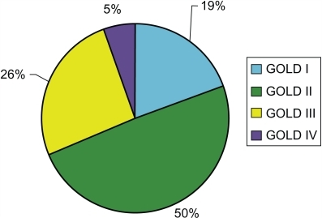
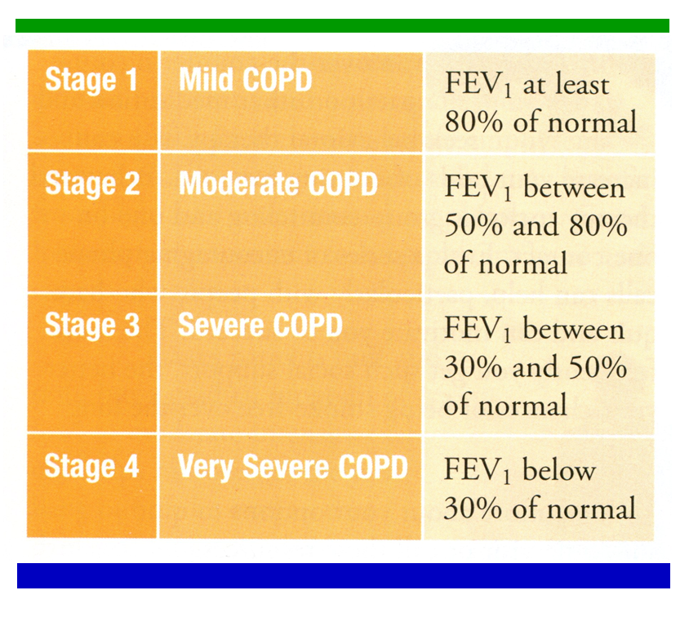
PFT
Post-bronchodilator FEV1/FVC < 0.70 = “COPD exists”
Post-bronchodilator FEV1 = “How bad is it?”
Classification of Severity:
Notes:
Primary care providers taking care of patients with COPD are REQUIRED to have access to spirometer.
Is peak flow of any value for COPD?
How accurate are primary care providers at making the diagnosis of COPD? * we are wrong 30% of the time on initial dx (Podcast, Peer View, 2014)

Slide 17
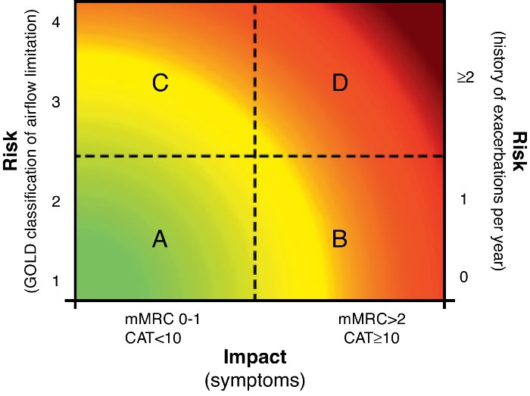
Assessment of Symptoms
Validated Questionnaires:
1) COPD Assessment Test (CAT)
2) Clinical COPD Questionnaire (CCQ)
3) British Medical Research Counsel (mMRC)

Slide 18
COPD Assessment Test (CAT)
Type of questionnaire-description Patient-completed questionnaire assessing globally the impact of COPD (cough, sputum, dyspnea, chest tightness) on health status
Number of items 8 (one question assessing impact on sleep)
Number of domains & categories Uni-dimensional
Name of categories/domains N/A
Scaling of items 1 to 5
Scoring Range of CAT scores from 0–40. Higher scores denote a more severe impact of COPD on a patient’s life.
The difference between stable and exacerbation patients
was five units. No target score represents the best
achievable outcome.

Slide 19
Management of COPD
Relieve symptoms
Improve exercise tolerance
Improve health status
Prevent disease progression
Prevent and treat exacerbations
Reduce mortality
REDUCE SYMPTOMS
REDUCE RISK

Slide 20
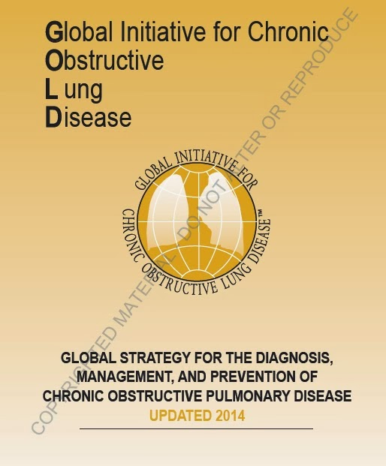
Therapeutic Options: Non-Pharmacologic

Slide 21
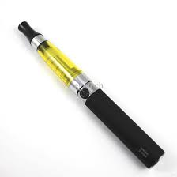
Therapeutic Options: Smoking Cessation
Greatest capacity to influence disease progression.
- 5 As: Ask, Advise, Assess, Assist, Arrange
- 3 minute period of counseling = quit rate of 5-10%
(GOLD, 2016)
All therapies “reliably" increase LT smoking abstinence:
- Chantix (varenicline)
- Zyban (bupropion)
- Nicotine Replacements (all types)
- E-cig = NO evidence
Notes:
Effectiveness of:
Chantix
Zyban
E-cig

Slide 22
Therapeutic Options: Reduce Exposure

Slide 23
Therapeutic Options: Nutrition
Nutrition:
- 1/3 of COPD patients are malnurished
- low BMI have worse prognosis with more exacerbation
- Sarcopenia: loss of skeletal muscle/atrophy of fibers
- Cachexia: general wasting from chronic disease
- decline of respiratory function from O2/CO2 imbalance
- most common in emphysema
Recommendations: high fat, high calories, Omega-3, protien, Vitamin D have all demonstrated positive effect on outcomes
(Hsieh, Tsung-Ming, & Tsai, 2015)

Slide 24
Therapeutic Options: Exercise
Must improve muscle mass and physiologic function
Breathing retraining
Pursed lip breathing
Diaphramatic breathing (all supine & sitting position)
Upper/Lower body exercises
Walking 15 minutes
Systematic Review: (Puhan, et al., 2005) insufficient evidence to recommend nutritional intervention alone. Improved outcomes with nutrition + physical activity
(Suagawara, et al., 2010)

Slide 25
Therapeutic Options: Immunizations
Influenza annually, Tdap as appropriate
PCV13 (Prevnar) + PPSV23 (Pneumovax)
Both should be routinely given to all adults age >65 yr in series
Will be re-evaluated in 2018
MMWR/September 19, 2014/Vol. 63/No. 37

Slide 26
Therapeutic Options: Pulmonary Rehabilitation
Determinants of Successful Rehab Completion (2016)
Generally 8 weeks
Benefits are known
Only 10% of patients are referred post hospital D/C
60% attrition rate
440 included, 229 completed
41% female; 17% African American
Completers = lower pain, lower Beck Depression Score, lower rate of smoking
(Brown, et al., 2016)

Slide 27
Therapeutic Options: Pulmonologist Referral
Among general practitioners:
Fail to recognize early disease
Ownership of PFT is related to guideline adherence
Overall provide poor care compared to specialist
MUST refer to establish diagnosis/stage
ICD 10 requires staging
Goktalay, et al. (2015). Knowledge Level of Primary Healthcare Providers on COPD and Pulmonary Rehabilitation. Pulmonary Medicine, doi:http://dx.doi.org/10.1155/2015/538246

Slide 28
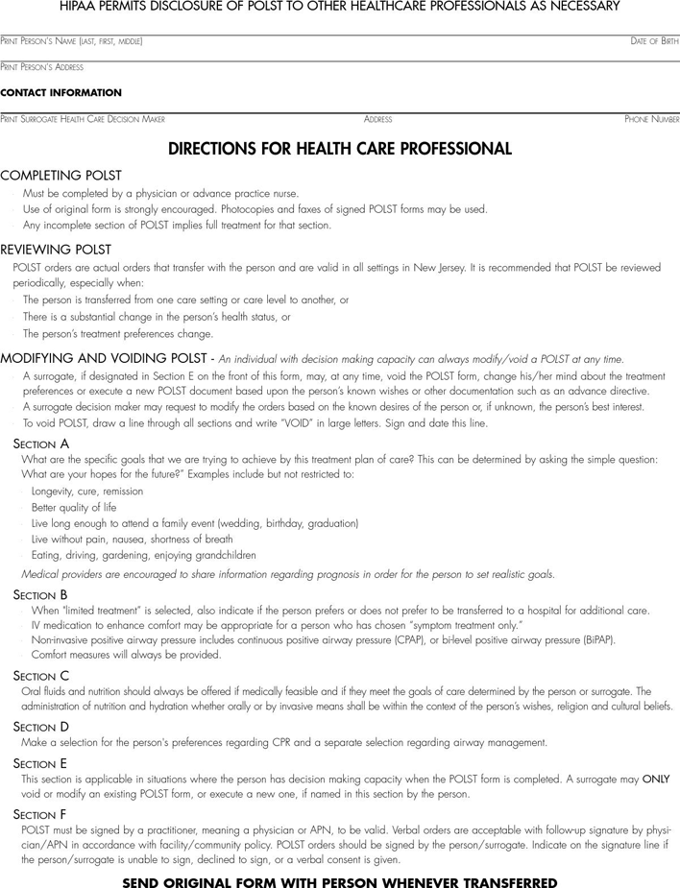
Therapeutic Options: End-Of-Life Planning & Decision Making
NJ POLST: Can be signed by APN or MD ONLY
- 99497
- 99498 (each additional 30 min)
- $86, $75
Palliative Care Needed:
- Heart Failure
- COPD is a PREDICTOR of HF mortality
- Beta-Blockers are NOT necessarily contraindicated
(Grivanni, et al., 2015)

Slide 29
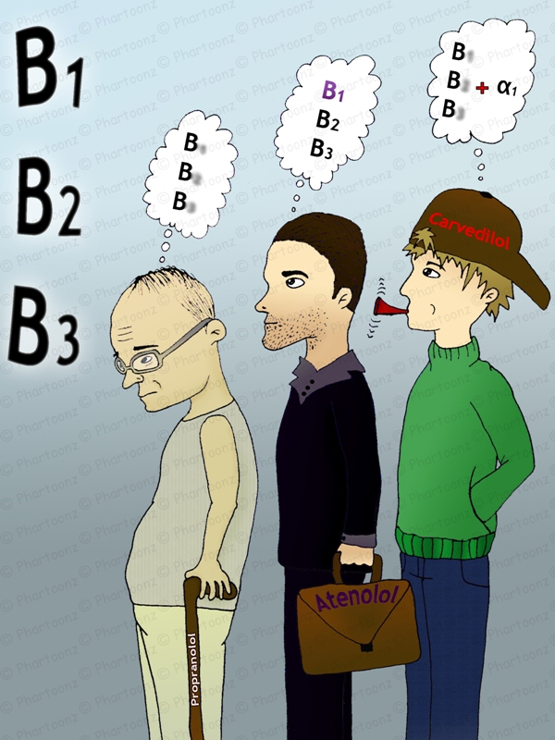
Comorbidity: Heart Failure A Quick Word: “No one has JUST COPD…” – Dr. Bradshaw
GOLD 2014:
Cardiovascular Disease: Heart Failure
Osteoporosis
Anxiety/Depression
Lung Cancer
Infections
Metabolic Syndrome
Diabetes
Bronchiectasis
Cardio-selective beta-blockers
are NOT contraindicated
with COPD = give it!
“To give or not give the beta-blocker?”
Notes:
Use of Beta Blockers: Who wins?
Guder & Rutten (2014). Cormorbidity of Heart Failure and COPD: More than a Coincidence. Curr Heart Fail Resp (2014) 11, 337-346

Slide 30
Therapeutic Options: Pharmacologic (PDE-4inh)
Daliresp (roflumilast)
- Indications: To reduce risk of COPD exacerbations in severe COPD patients with chronic bronchitis and a history of exacerbations. Limitations of use: not for the relief of acute bronchospasm
- Mechanism of Action: PDE-4 inhibitor
- Dosing: 500mcg once daily
- Contraindications: Moderate-to-severe liver impairment
- Interactions: Concomitant strong CYP450 inducers (eg, rifampicin, phenobarbital, carbamazepine, phenytoin): not recommended. Potentiated by CYP3A4 and CYP1A2 inhibitors (eg, erythromycin, ketoconazole, fluvoxamine, enoxacin, cimetidine), and by oral contraceptives containing gestodene + ethinyl estradiol (possible increased adverse effects)
- Precaution/Warning: Diarrhea, weight decrease, nausea, headache, back pain, influenza, dizziness, decreased appetite; psychiatric effects (eg, insomnia, anxiety, depression)

Slide 31
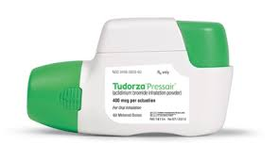
Therapeutic Options: Pharmacologic: RECALLED LOTS
Tudorza PressAir (aclidinium bromide)
- Approved by the FDA
- Indications: Long-term, maintenance treatment of bronchospasm associated with COPD, including chronic bronchitis and emphysema
- Mechanism of Action: Long-Acting Anticholinergic
- Dosing: 400mcg twice daily
- Contraindications: Not for initial treatment of acute episodes of bronchospasm. Narrow-angle glaucoma. Urinary retention. Milk protein sensitivity. Labor & delivery. Pregnancy (Cat. C). Nursing mothers.
- Precautions/Warnings: Headache, nasopharyngitis, cough; hypersensitivity reactions (discontinue if occurs), paradoxical bronchospasm possible

Slide 32
Therapeutic Options: Pharmacologic:

Slide 33
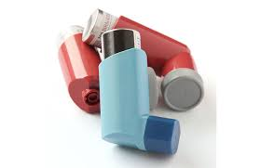
Therapeutic Options: Additional “Pearls” from GOLD 2016
Bronchodilators:
Long-acting is preferred over short-acting
Combination of short and long can be helpful
Use inhaled bronchodilators over oral
Theophylline is not recommended if bronchodilator is accessible

Slide 34
Exacerbation
Definition: “An acute event characterized by worsening of the patient’s respiratory systems that is beyond normal day-to-day variations and leads to a change in medication.”
Best Predictor: Hx of previous Tx events > 2x per Year
“I always get my bronchitis this time of year…”
“I just went to the ER because I needed…”
“I just took some left over…because I had it…”
***Remember: 50% don’t even know they have COPD

Slide 35
Exacerbation Reimbursement
CMS National Strategy for Quality Improvement in Health Care
GOAL = reduce readmission rates by 20% by end of 2013*
Penalty for COPD readmission within 30 days:
- Adherence
- Continuity of Care
- Cost
- Comorbidity (No one JUST has COPD)
F.M. van Boven, J., Chavannes, N., T. van der Molen, T., Rutten-van Molken, M., Postma, M., & Vegter, S. (2014). Clinical and economic impact of non-adherence in COPD: A systematic review. Respiratory Medicine (2014) 108, 103-113.
Notes:
Is anyone seeing denial of payment?

Slide 36
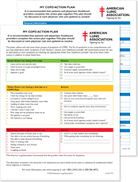
COPD Action Plans
American Lung Association (2016)

Slide 37
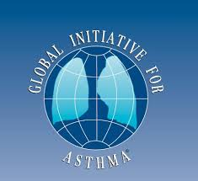
ACOS Syndrome Asthma – COPD Overlap Syndrome
Key Points:
Distinguishing Asthma from COPD is difficult
ACOS is identified by the features shared with both
Initial treatment should ensure:
Patients with features of asthma get adequate controller therapy, including ICS but not LABA alone
Patients with features of COPD get symptomatic treatment, but not ICS alone
Confirmatory investigation is encouraged= PFT
GINA: http://www.ginasthma.org
GOLD: http://www.goldcopd.org

Slide 38
Summary
YOU

Slide 39
References
Choi, J., Chung, H., & Han, G. (2013). Patient outcomes according to COPD action plan adherence. Journal of Clinical Nursing, 23, 883-891.
Goktalay, et al. (2015). Knowledge Level of Primary Healthcare Providers on COPD and Pulmonary Rehabilitation. Pulmonary Medicine, doi:http://dx.doi.org/10.1155/2015/538246
Guder, G. & Rutten, F. (2014). Comorbidity of Heart Failure and COPD: More than Coincidence. Current Heart Failure Rep 11, 337-346.
Hsieh, M., Tsung-Ming, Y., & Tsai, Y. (2015). Nutritional supplementation in patients with COPD. Journal of the Formosan Medical Association, doi: http://dx.doi.org//10.1016.J.jfma.2015.10.008
Jones, P., Watz, H., Wouters, E., & Cazzola, M. (2016). COPD: the patient perspective. International Journal of COPD, 11, 13-20.
Kaplan, A. (2009). The COPD Action Plan. Canadian Family Physician, 55, p. 58-59.
Montserrat-Capdevila, J., Godoy, P., Marsal, J., Barbe, F., & Galvan, L. (2015). Risk of exacerbation in COPD: a primary care retrospective cohort study. BMC Family Practice, 2015 16:173.
Sugawara, et al. (2010). Effects of nutritional supplementation combined with low-intensity exercise in malnourished patients with COPD. Respiratory Medicine, 104, 1883-1889.
Suh, E., Mandal, S., & Hart, N. (2013). Admission prevention in COPD: non-pharmacological management. BMC Medicine, 11:247.
Van Boven, J., et al. (2013). Clinical and economic impact of non-adherence in COPD: a systematic review. Respiratory Medicine 108, 103-113.

Slide 40
Contact Information
Dr. Molly J. Bradshaw DNP, APN, FNP-BC, WHNP-BC
Rutgers School of Nursing
65 Bergen Street, SSB 1134
Newark, NJ 07170
Email: bradshmo@sn.rutgers.edu

